Slide 1

Guess Who? A simple polyclave classifier
Hui Kwok Lun
Edx Username :Hui Kwok Lun
Github Username: tsa4a12
CITY: HKSAR, China
Date: 2024/09/28

Slide 2
What’s this game?
2-player game
Ask question so you can pinpoint your opponents character
Whoever use less question to guess the correct character wins

Slide 3

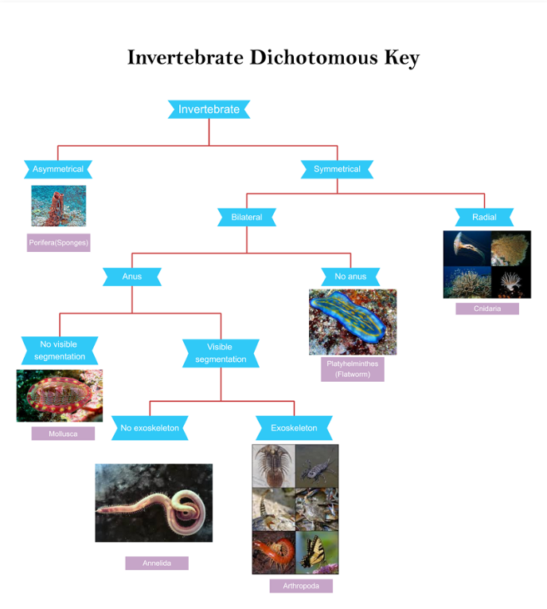
What’s so special about this game?
Information theory says the optimal solution of this game is to ask question that divides the population evenly, or at least as evenly as possible.
It can also be applied on Classification!
Traditional Dichotomous tree / taxonomic key characters are meaningful but inefficient in classifying in action
Polyclave classification could prioritize the characteristics that gives most information

Slide 4
This program…
Takes in the Guess who Excel info sheet as csv file
Choose one of the most informative characteristic
Asks a yes/no question and does the filter (It’s okay to be unsure!)
Output the final guess if your information is sufficient/ a list of possibilities if not

